Slide 1
OUR way(s) forward
Decisions facing West End United Methodist Church
Post-General Conference February 2019

Slide 2
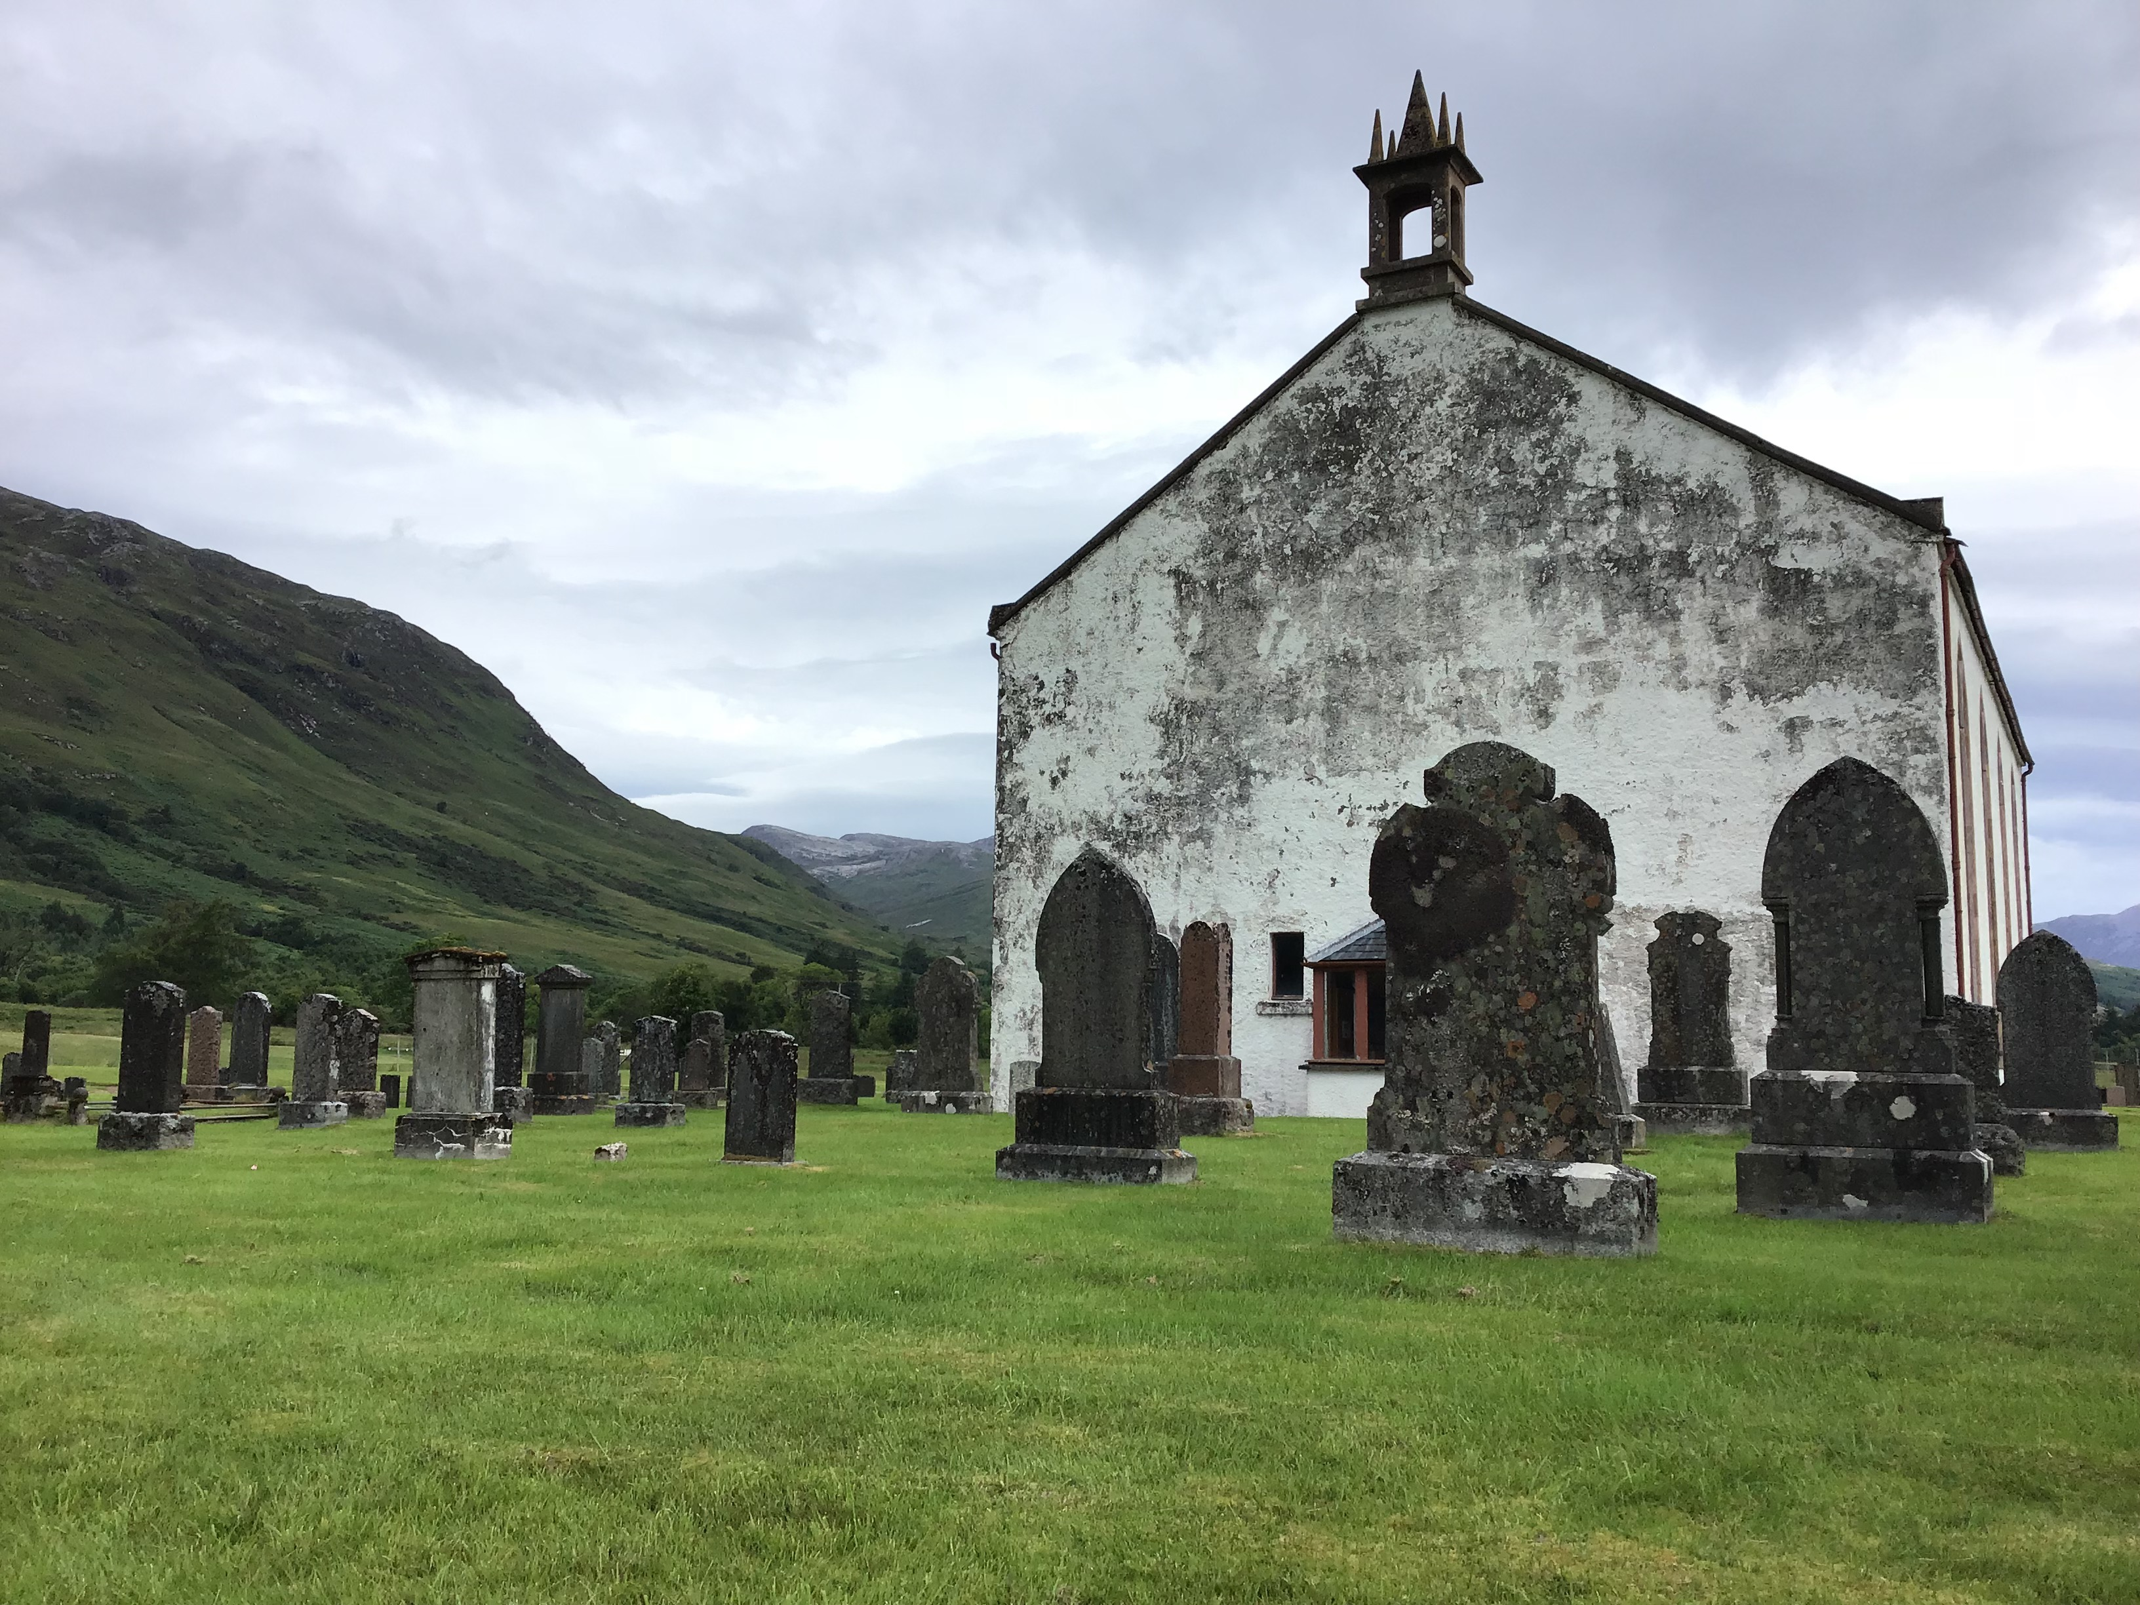

Slide 3
Our Way(s) Forward
General Conference has many options
It could adopt the One Church Plan, as advanced by Way Forward Commission & recommended by Council of Bishops
It could adopt either of the other plans advanced by the Way Forward Commission
Connectional Conference Plan
Traditionalist Plan
It could deadlock
Each of these paths has implications for our church

Slide 4
One Church Plan
“Practices among vital churches need room to thrive”
Removes present Discipline language re ordination & marriage
Voting is kept to a minimum
OUR CHURCH
We could amend wedding policies re building use
No decision required re pastors performing marriage ceremonies
No voting required, but…
OUR CLERGY
TN Conference could ordain LGBT pastors
Require Board of Ordained Ministry recommendation & clergy vote
Pastors may transfer

Slide 5
Connectional Conference Plan
“Three values-based connectional conferences” replace five US jurisdictions
Requires most institutional change
Each connection writes its own Book of Discipline
OUR CHURCH
We could vote to align with any connectional conference we choose
We could choose our marriage rules by connectional conference affiliation
Annual conferences choose, too
OUR CLERGY
Clergy would align with the conference(s) of their choice & abide by those ordination rules
Bishops would appoint considering connectional conference affiliation

Slide 6
Traditionalist Plan
Emerged at next-to-last meeting of Way Forward Commission
Requires least institutional change
Built on current Book of Discipline language re ordination & marriage
OUR CHURCH
Annual conferences would pledge to enforce LGBT language uniformly—conferences that do not would lose rights to UMC name, logo, and funding
Churches could leave
OUR CLERGY
Clergy performing same-sex marriage or found to be LGBT would face summary surrender of credentials
Bishops would pledge to enforce Discipline language, or leave

Slide 7
Deadlock?
It is possible General Conference may not support any of the Way Forward models
This would result in no change to Book of Discipline or UMC structure
This would also challenge clergy, congregations, and conferences
The Council of Bishops did not recommend a “gracious exit” path, as discussed by Commission
The Council & Commission’s work, instead, provides “a model for discernment” for each church and conference

Slide 8
our way(s) forward
Questions?

