Slide 1
2019 Town Hall
West End United Methodist Church

Slide 2
Welcome
Amy Lynch, Chair of 2019 Ministry Table

Slide 3
Where We’ve Been
Carol Cavin-Dillon, Senior Pastor

Slide 4
Our deeper past…
Methodism and slavery
The abolition of the Central Jurisdiction in 1968 and 1970 at a called General Conference
Exclusion and inclusion of women
Women given full clergy rights at GC 1956.
History of Racism
History of Sexism

Slide 5
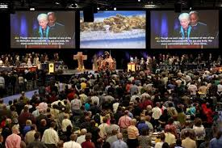
Our recent past…
The Book of Discipline since 1972
General Conference 2016
The Commission on a Way Forward
General Conference 2019

Slide 6
Response at West End
Service of Lament
Ministry Table voted to redo our banners and highlight our Welcome Statement
Ministry Table voted to join other local UMC’s in an ad in Pride Magazine
Ministry Table, pastors and leaders continued to listen and create space for conversation
Way Forward Team shifted its role

Slide 7
After February
UMC Next
Mainstream UMC
UM Forward
Wesley Covenant Association

Slide 8
What’s Been Proposed?
Davis Turner, Chair of 2020 Ministry Table

Slide 9
GC2020 Proposals
Indianapolis Plan
UMCNext Plan
UM Forward

Slide 10
“You will discover that you either
need to walk together more loosely
or part with a blessing.”

Slide 11
Barnabas wanted to take with them John called Mark. But Paul decided not to take with them one who had deserted them in Pamphylia and had not accompanied them in the work. The
disagreement became so sharp that they parted company; Barnabas took Mark with him and sailed away to Cyprus. But Paul chose Silas and set out, the believers commending him to the grace of the Lord.
Acts 15:37-40

Slide 12
Indianapolis Plan
www.emobodygrace.com

Slide 13
Indianapolis Plan
Pathway for Traditionalist and Progressive (if desired) denominations. UMC shall continue as Centrist UMC**.
**Modifiers for names.
US Annual Conferences decide by majority vote. If AC decides not to vote, they remain in the Centrist UMC. Local churches disagreeing would decide by majority vote to align with a different denomination.
Clergy and Bishops self-align

Slide 14
Indianapolis Plan
Any AC, congregation or clergy choosing to align with any denomination OTHER than Traditionalist, would be exempt from the restrictive provisions related to marriage, ordination, etc. following adjournment of GC2020.
Wespath, UMCOR, UMM and Publishing House continue as independent organizations. All other Boards and Agencies continue in the Centrist UMC.

Slide 15
Indianapolis Plan
Central Conferences, ACs and local churches choose by simple majority. If they do not vote by March 31, 2021, they default to Traditionalist UMC.
Central Conferences would be supported by all denominations in the 2021-2024 UMC budget.
Process for church assets will be determined by GC2020.

Slide 16
Indianapolis Plan
The intention was to create a starting point IF amicable separation is the will of the General Conference. What will Africa and the Philippines do?
They understand GC delegates will change portions of the plan
They understand Judicial Council will need to rule on items and may require some changes

Slide 17
UMC Next Plan
www.umcnext.org

Slide 18
UMC Next Plan
A moratorium on charges
Repeal the Traditional Plan
Remove discriminatory language in the Book of Discipline

Slide 19
UMC Next Plan
Separation with property is made possible for churches
New Denominational Expressions where departing churches can gather
2/3rds affirmative vote

Slide 20
UMC Next Plan
May 2020 – General Conference
Moratorium on charges, complaints and trials
Pass disaffiliation legislation
Pass Resource Allocation Formula
Create Commission on the 21st Century Church
Call for a 2023 Special Session of the General Conference

Slide 21
UMC Next Plan
May 2023 – Called General Conference
Remove all restrictive language in The Book of Discipline related to marriage, ordination, etc.
Regional Conference legislation
Adaptable Book of Discipline
Report of the Commission on the 21st Century Church

Slide 22
UM Forward Plan
www.um-forward.org

Slide 23
UM Forward Plan
Dissolves the United Methodist Church
Creates four new global Methodist denominations
Traditionalist Methodist Church
Moderate Methodist Church
Progressive Methodist Church
Liberation Methodist Church
Plan of separation presented to a Special General Conference before 2024

Slide 24
I am about to do a new thing;
now it springs forth, do you not perceive it?
I will make a way in the wilderness
and rivers in the desert.
Isaiah 43:19
And the one who was seated on the throne said,
“See, I am making all things new.”
Revelation 21:5

Slide 25
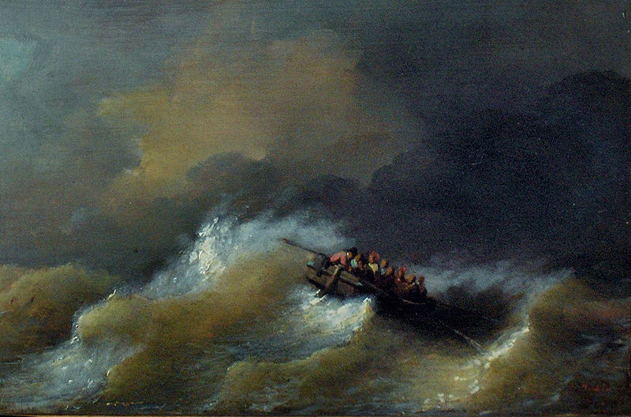
The Perfect Storm

Slide 26
The Perfect Storm
The global church
The voting process and majority rule
The limitations of General Conference
Meanwhile, people are hurting and our witness in the world is suffering.

Slide 27
“Our system no longer works.”
Bishop John Scholl, New Jersey

Slide 28
What about West End?
Celebrate our Welcome Statement
Continue to live and love into it
Continue to love one another
Care for one another and yourself as we stand in the tension
Prepare to act

Slide 29
Discernment Team
Kirby Davis
Marty Gentry
Trey Harrell
Haley Hendren
Jeff Howerton
Fern Richie
Sue Smith
Carol Cavin-Dillon

Slide 30
Questions and Conversation

