Slide 1
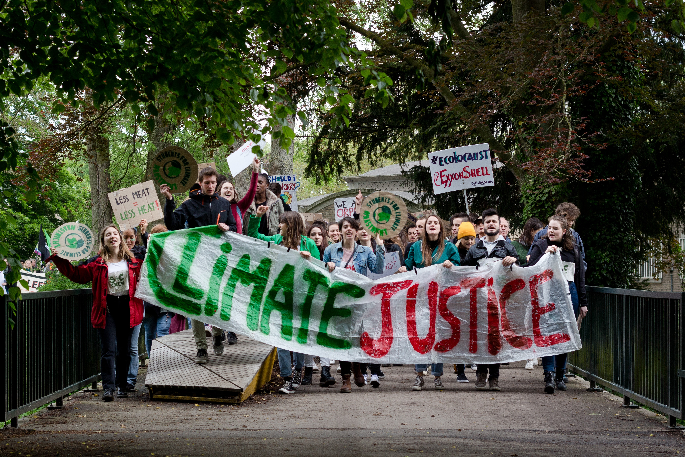
Notes:
You’ve definitely heard of climate change and creation care, but more and more you’ll be seeing the word “justice” attached.
Why have we gone from talking about climate and creation to now including justice?

Slide 2
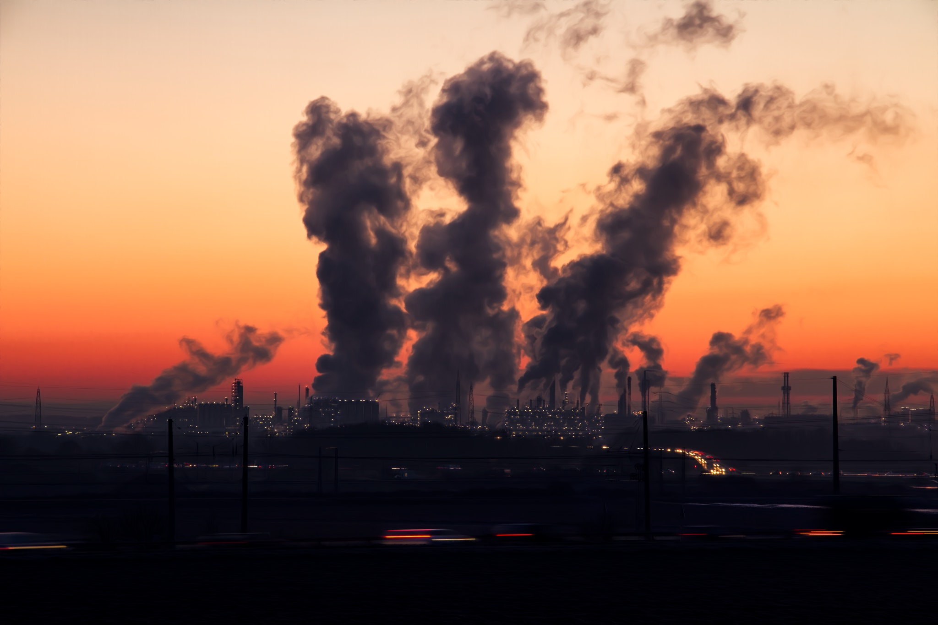
Notes:
We’ve all seen the billowing smoke or steam from major industrial sites and energy plants. What we don’t see are the particulates of pollution. What seems to evaporate into the endless sky really doesn’t.

Slide 3
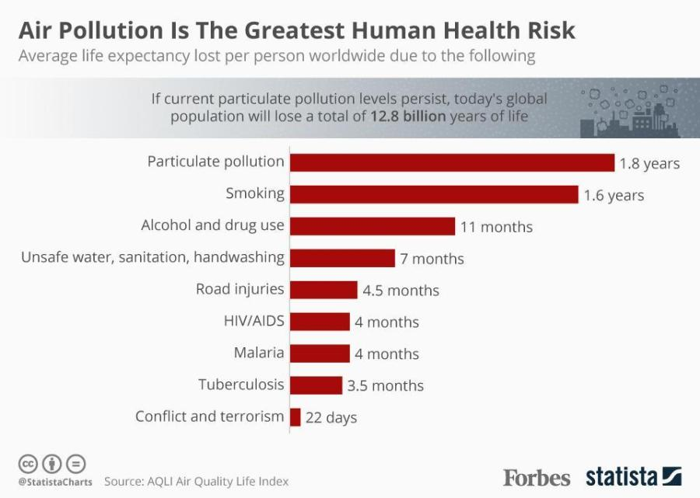
Notes:
Air pollution is the greatest human health risk, even compared with this list of major factors that decrease average life expectancy. This chart shows 1.8 years lost, but the latest report now says Particulate Pollution diminishes life by 3 years. If we were to extend that top line to 3 years, it would be just short of twice as long as the years lost to smoking.

Slide 4
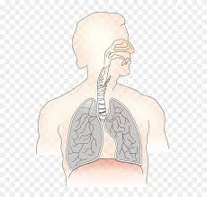
Notes:
No one needs to think of average, when it comes to a child with asthma or another loved one with COPD or cancer or another life-threatening disease of the lungs.
A good sign is that as the risks have become better known, the push for making the manufacturing plants safer has increased.

Slide 5
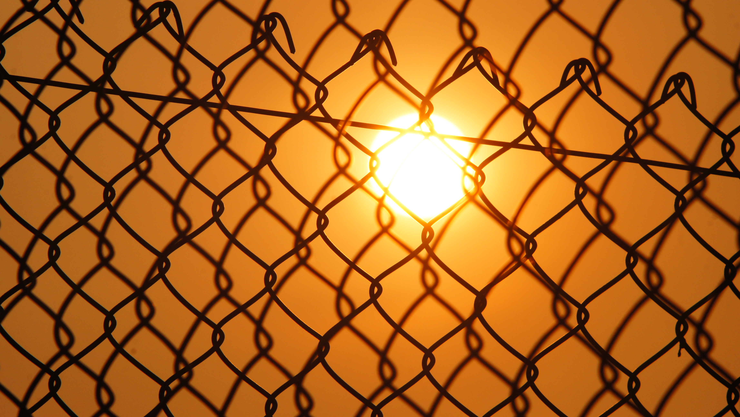
Notes:
But often the major response from the offender is to put up a fence to ”keep people safe.”
This action has given rise to a new term, “Fence line communities.” Because of property costs, the people who have to live close to polluters are poor and consequently have little choice in the matter.
Hear what our UM Social Principles say:
"The negative effects of degradation of the natural world have fallen disproportionately on marginalized communities—people of color, indigenous tribes, people living in poverty, and developing countries. They bear the brunt of hazardous environments, industrial pollution, toxic waste dumps and urban decay, drought, and sea level rise."

Slide 6
UM Social Principles
"The negative effects of degradation of the natural world have fallen disproportionately on marginalized communities—people of color, indigenous tribes, people living in poverty, and developing countries. They bear the brunt of hazardous environments, industrial pollution, toxic waste dumps and urban decay, drought, and sea level rise."
Notes:
READ THE SLIDE ALOUD
Hear what our UM Social Principles say:
"The negative effects of degradation of the natural world have fallen disproportionately on marginalized communities—people of color, indigenous tribes, people living in poverty, and developing countries. They bear the brunt of hazardous environments, industrial pollution, toxic waste dumps and urban decay, drought, and sea level rise."

Slide 7
UM Social Principles
"These groups suffer disproportionately from higher rates of asthma, cancer, birth defects, malnutrition, and other preventable medical conditions. These health problems are associated with pollutants and other chemicals in soil, water and air that affect our drinking water, foods and physical environment."
Notes:
READ THE SLIDE ALOUD!
People in fence line communities don’t have the power to say “NOT in my backyard.” They don’t have the resources to fight the powers that be.
People subjected to these threats to their own and their family’s health, often have to take time off work to care for sick children or other vulnerable family members. That means lost wages. And you know the consequences of taking off too much time from a job—you get fired!
Children out of school repeatedly fall behind in education and struggle with connecting to classmates and teachers. The pipeline to prison starts by third grade, sweeping those who can’t keep up with schooling into a life that is not what any of us want for any child.
IF NEEDED: FAILURE TO CONNECT WITH TEACHERS/AUTHORITY OR CLASSMATES/OTHER HUMAN BEINGS IS OFTEN A FACTOR IN GUN VIOLENCE.

Slide 8
Food Deserts
How many sources of good, nutritious food are within 5 miles of where you live?
Notes:
I can count 8! (DO YOUR OWN COUNT)
Did you even count convenience stores?
If you live in a fence line community, you likely live in a food desert, as well.
A small convenience store may be your best hope for food. Especially if you don’t have easy access to a car.

Slide 9
UM Social Principles
"Food systems that are ecologically sustainable, locally oriented, and equitably distributed are urgent priorities."

Slide 10
NIMBY! NIMBY! NIMBY!
N NOT
I IN
M MY
B BACK
Y YARD
! !!!!!
Notes:
The NIMBY chant, “not in my backyard,” also applies to landfills. With increasing population and increasing consumption of goods, landfills fill up! And they are doing so at faster rates.
Nashville's major existing landfill is projected to last at the current rate for only 2 more years. Our landfill is 50 miles away, meaning we're dumping in someone else's backyard! NIMBY!
And every truck that goes the 100 miles there and back adds to the CO2 in the air.

Slide 11
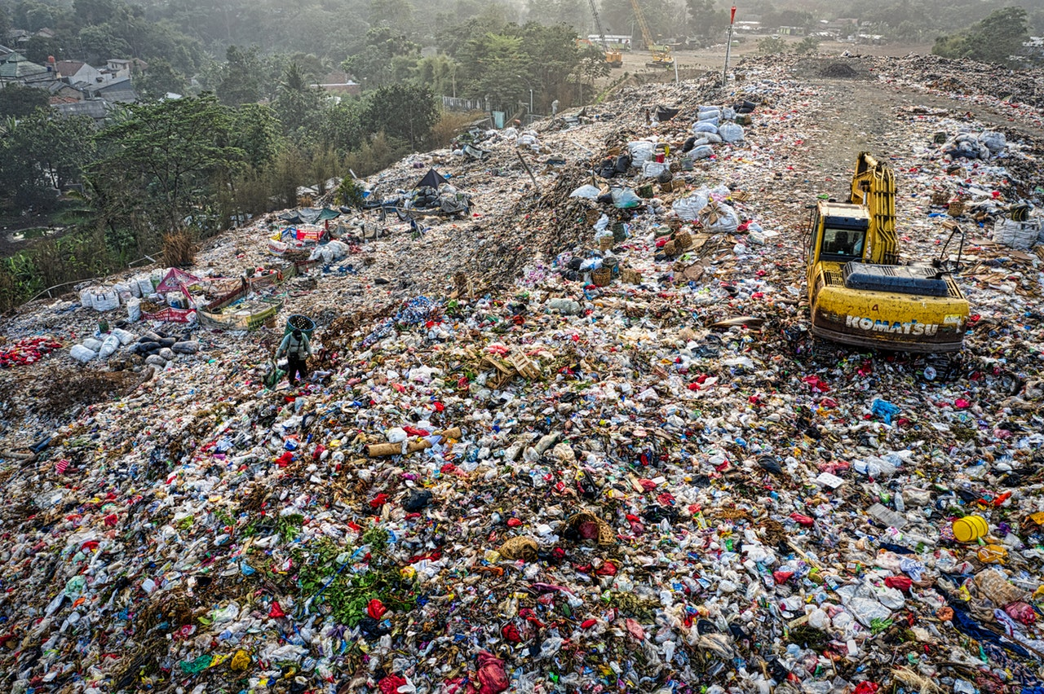
Notes:
Landfills are also a significant source of methane, one of the most virulent of the Greenhouse Gases.
Nobody wants to live near a landfill, but notice the houses at the foot of the hill. You can bet there is a fence line there also.
Again, marginalized communities—people living in poverty, people of color—get stuck with everyone else’s trash.
IF ASKED, THE LANDFILL THIS TALKS ABOUT IS IN REUTHERFORD COUNTY. THE LANDFILL OFF BRILEY PARKWAY IS ONLY FOR CONSTRUCTION WASTE. WITH A BOOM CITY WE HAVE BEEN ADDING TO IT AT AN INCREASING RATE AS WELL. IN ADDITION, DEBRIS FROM THE RECENT TORNADO IS SIGNIFICANTLY STRESSING THAT FACILITY.

Slide 12
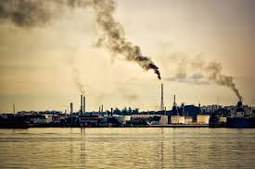
Notes:
Our waterways have no defense from toxic waste that is either dumped or leaks into them. Those same waterways are also the source of human drinking water.
Again marginalized communities, people in poverty, people of color pay a greater price. Think of lead in the water of Flint, Michigan. It's not the affluent neighborhoods who still wait for remediation while watching their children suffer long-term brain damage.
Recall Hurricane Katrina. A community of color, the 9th Ward, was hit hardest and has still not recovered, although the rest of New Orleans has.
IF NEEDED, REMIND FOLKS THAT THE WATERWAYS ARE ALSO HOME TO MARINE LIFE, INCLUDING FISH THAT PEOPLE EAT.

Slide 13
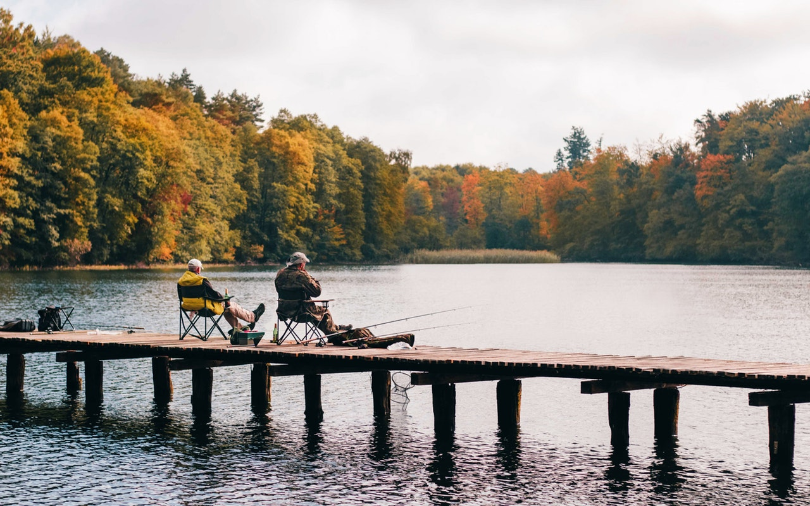
Notes:
Our own Tennessee River is not safe from plastic pollution. According to Congressman Jim Cooper, “A test of our own Tennessee River found we have one of the most plastic-polluted rivers in the world, and we have more microplastic pollution than the Yangtze River in China.”
That means the fish people are eating are ingesting microplastics!

Slide 14
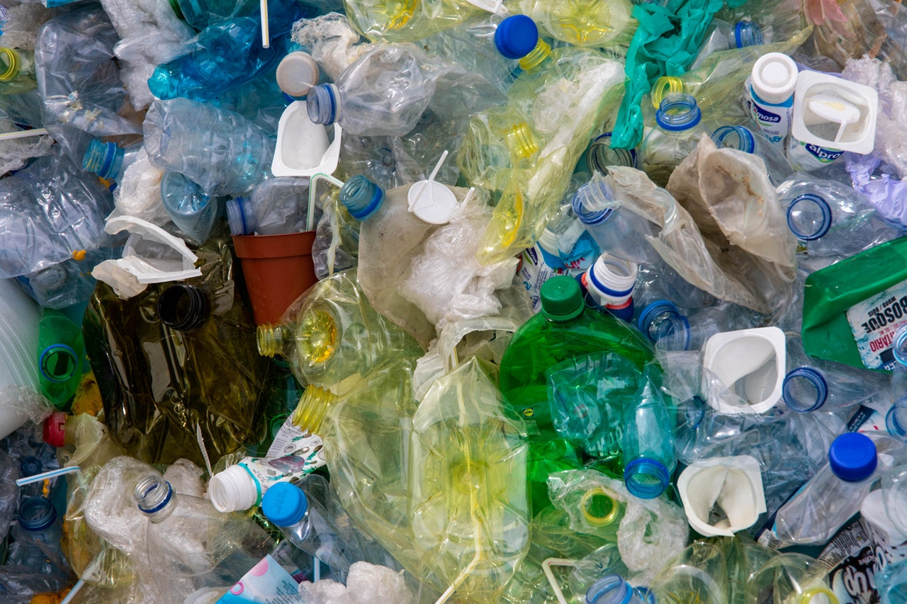
Notes:
Air, land, and water pollution—all degrade the earth—and the lives of the people in their vicinity. Plastic is another huge polluter. We used to think we could recycle our way out of that mess, but that is pretty much a pipe dream.
Made of fossil fuels, plastic doesn’t go away, but breaks down into microplastics that lodge in our landfills, streams, rivers, and oceans and harm God’s creation.
Single-use plastic bottles, bags, straws, and cups are especially hard on creation.

Slide 15
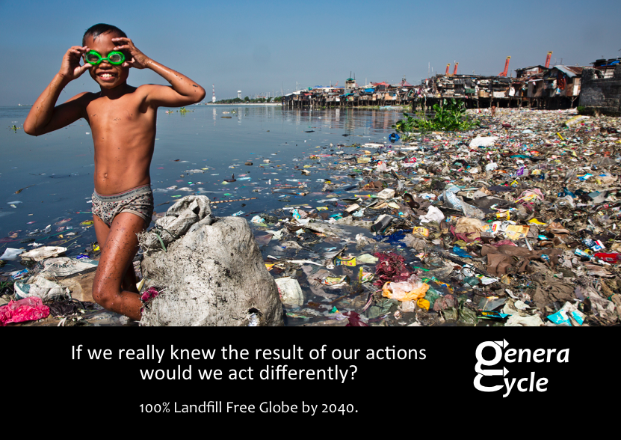
Notes:
And especially hard on countries with few resources!
Humanity cannot continue to spew toxins into the air, fence off the danger, cover over the mountains of throwaways, engage in practices that poison the water, or expect other countries to clean up.

Slide 16
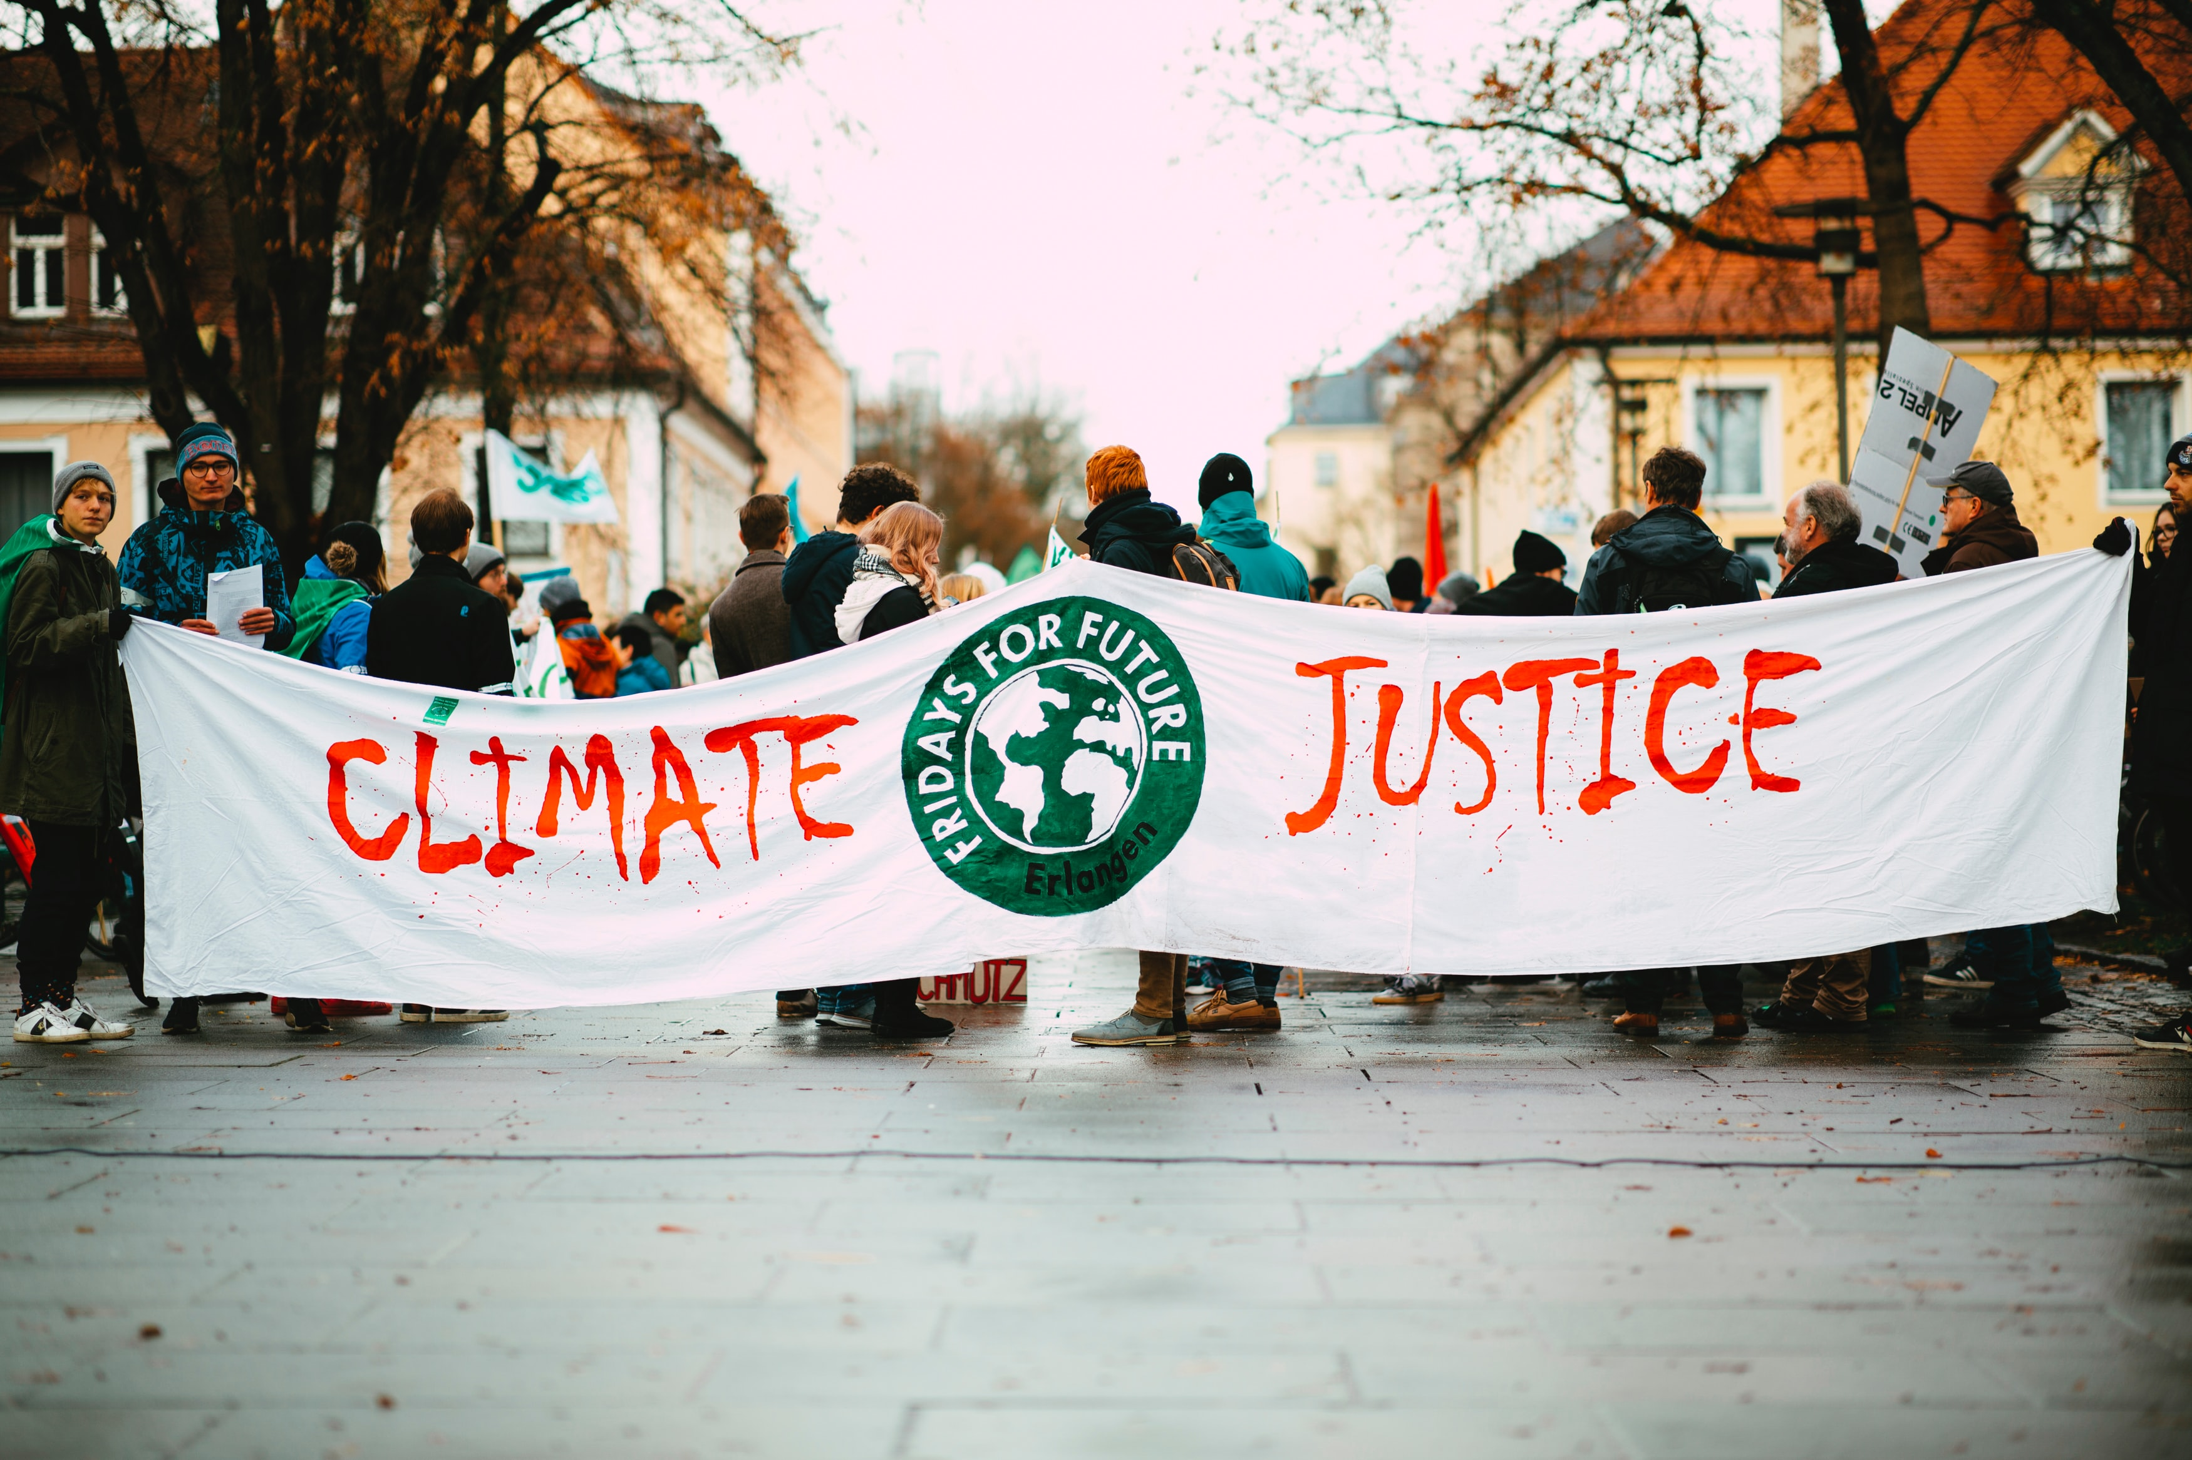
God calls us to stand up, speak up, and step up for justice!
Notes:
We follow Jesus Christ who has told us to love God and love our neighbor. The climate crisis reminds us that we are all neighbors.
All of us will feel the effects of global warming to some degree. But some are already experiencing harsh consequences. God call us to stand up, speak up, and step up for justice!
(YOU CAN ASK THE GROUP TO READ ALOUD WITH YOU THE “GOD CALLS” STATEMENT.)

